Slide 1
Replication and Reproducibility in Social Sciences and Statistics: Context, Concerns, and Concrete Measures
Lars Vilhuber
Cornell University
Partial funding acknowledged under NSF-#1131848 (NCRN) and a grant from the Alfred P. Sloan Foundation. The opinions expressed in this talk are solely the authors, and do not represent the views of the U.S. Census Bureau, the American Economic Association, or any of the funding agencies.

Slide 2
Overview
Crisis, what crisis?
A brief history of reproducibility and replicability
What seems different today?
Economics and other social sciences
What are we doing in Economics? (at the AEA, in general)
What are we going to do in Economics?
What will you be doing going forward?

Slide 3
Crisis, what crisis?
History of discussions about replicability (Nosek)

Slide 4
Introducing: The Reproducibility Crisis

Slide 5
Replicability in Economics
Ragnar Frisch, editor of the first issue of Econometrica (1933), noted
“the original data will, as a rule, be published, unless their volume is excessive… to stimulate criticism, control, and further studies.”
Publication of data, however, was discontinued early in the journal’s history.
Frisch (1933)

Slide 6
The “crisis” in the 60s and 70s Sterling, 1959; Cohen, 1962; Lykken, 1968; Tukey, 1969; Greenwald, 1975; Meehl, 1978; Rosenthal, 1979
Low power
Flexibility in analysis
Selective reporting
Ignoring nulls
Lack of replication
Misuse of statistics
Notes:
Source: Nosek, NAS.Sackler.2017.03.10
Examples from:
Button et al – Neuroscience
Ioannidis – why most results are false (Medicine)
GWAS
Biology
Two possibilities are that the percentage of positive results is inflated because negative results are much less likely to be published, and that we are pursuing our analysis freedoms to produce positive results that are not really there. These would lead to an inflation of false-positive results in the published literature.
Some evidence from bio-medical research suggests that this is occurring. Two different industrial laboratories attempted to replicate 40 or 50 basic science studies that showed positive evidence for markers for new cancer treatments or other issues in medicine. They did not select at random. Instead, they picked studies considered landmark findings. The success rates for replication were about 25% in one study and about 10% in the other. Further, some of the findings they could not replicate had spurred large literatures of hundreds of articles following up on the finding and its implications, but never having tested whether the evidence for the original finding was solid. This is a massive waste of resources.
Across the sciences, evidence like this has spurred lots of discussion and proposed actions to improve research efficiency and avoid the massive waste of resources linked to erroneous results getting in and staying in the literature, and about the culture of scientific practices that is rewarding publishing, perhaps at the expense of knowledge building. There have been a variety of suggestions for what to do. For example, the Nature article on the right suggests that publishing standards should be increased for basic science research.
[It is not in my interest to replicate – myself or others – to evaluate validity and improve precision in effect estimates (redundant). Replication is worth next to zero (Makel data on published replications; motivated to not call it replication; novelty is supreme – zero “error checking”; not in my interest to check my work, and not in your interest to check my work (let’s just each do our own thing and get rewarded for that)
Irreproducible results will get in and stay in the literature (examples from bio-med). Prinz and Begley articles (make sure to summarize accurately)
The Nature article by folks in bio-medicine is great. The solution they offer is a popular one in commentators from the other sciences -- raise publishing standards.

Slide 7
The crisis in the 1980s in Economics
Dewald, Thursby, Anderson (AER, 1986)
Leamer’s (1983) ‘Let’s take the con out of econometrics’

Slide 8
Citing data sources
“Many authors cited only general sources such as Survey of Current Business, Federal Reserve Bulletin, or International Financial Statistics, but did not identify the specific issues, tables, and pages from which the data had been extracted.”
(Dewald Thursby Anderson 1986, p. 591)

Slide 9
Making USEFUL archives
From analysis of code from 1996 to 2003 (MMH2006):
“Other authors seem to think that the entire world shares the exact same hard drive layout, with ‘‘C:\MYDATA\MYPROJECT\” sprinkled liberally throughout their code. Of course, a would-be replicator has to find and change all these.”
“The author might not realize all the data/subroutine files that his code utilizes, and forget to include said data/subroutine in his replication files.”

Slide 10
The crisis in the 1980s … lead to changes
1976- JPE Section on Confirmation and Contradictions
1988 Replication archive at the Journal of Applied Econometrics

Slide 11
The crisis in the 1990s
Anderson and Dewald (1994) [Economics]
King (1995) “Replication, replication” [Political Science]
McCloskey and Ziliak, 1996: Do economists consider power calculations?
McCullough and Vinod (1999): call for replication archives

Slide 12
The crisis in the 1990s… lead to changes
Lead directly to
Data availability policies in Economics (1996: JCMB)
Replication section (Journal of Applied Econometrics, 2003)
More robust code archives (Goffe and Parks (1997), Eddelbüttel (1997): CodEC -> SSC)
Coincidental:
Better public-use data (IPUMS: Sobek and Ruggles, 1999)
Better open-source software (R Core Team, 2000)
New methods of exchanging manuscripts (early 90s, but publications: Ginsparg, 1997: arXiv; Krichel, 1997, Halpern 1998)

Slide 13
The crisis in the 2000s
McCullough & Vinod (2003) [Econometrics]
Ziliak and McCloskey (2004)
Anderson et al (2005, 2008), Vinod (2005)
Ioannides (2005)
McCullough et al (2006) Lessons learned JMCB, McCullough (2007)
Hamermesh (2007)
Koenker and Zeileis (2009)

Slide 14
The crisis in the 2000s… lead to changes
Lead directly to
Data availability policies in Economics (2005: AER)
Subsequently to many other top journals
Social Science Registry (2011) for pre-registration

Slide 15
The newest crisis
Ioannides (2016)
Ioannidis, Stanley, Doucouliagos (2017): bias, low power
Miguel et al (2014)
Chang & Li (2015)
Zimmermann (2015): Calls for a replication journal
Many others…
“statistically significant, novel, and theoretically tidy results are published more easily than null, replication, or perplexing results”

Slide 16
But is it a “crisis”?
crisis [kri´sis] (pl. cri´ses) (L.) 1. the turning point of a disease for better or worse; especially a sudden change, usually for the better, in the course of an acute disease. 2. a sudden paroxysmal intensification of symptoms in the course of a disease.

Slide 17
Scholarly Communications are Meant to Communicate
In the 17th century, scholars communicated by letter exchange
Collections of letters + editing became the first journals
Peer review was incorporated
But the review of a manuscript by an editor and two peers cannot possibly be equivalent to a full vetting
Rather, the back and forth in the pages of academic journals IS the discourse
In this view (also Hamermesh, 2007) bad publications (including those that do not privately replicate) die out, good publications withstand those tests

Slide 18
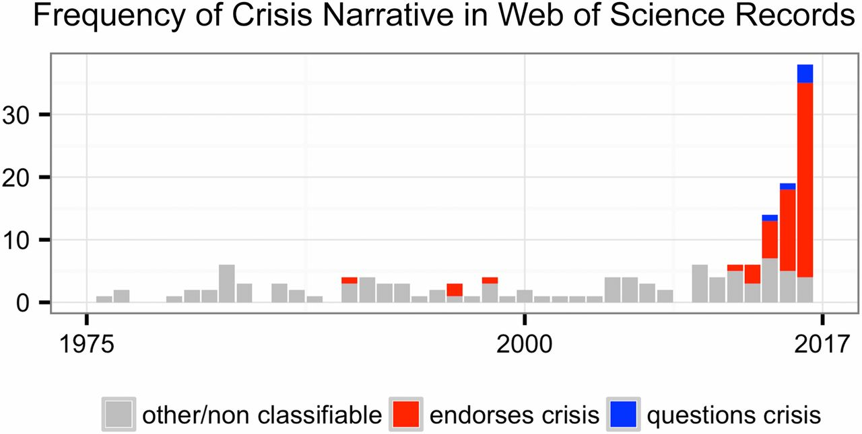
Fanelli (2018), Is science really facing a reproducibility crisis, and do we need it to?
https://doi.org/10.1073/pnas.1708272114
Notes:
Number of Web of Science records that in the title, abstract, or keywords contain one of the following phrases: “reproducibility crisis,” “scientific crisis,” “science in crisis,” “crisis in science,” “replication crisis,” “replicability crisis.” Records were classified by the author according to whether, based on title and abstracts, they implicitly or explicitly endorsed the crisis narrative described in the text (red), or alternatively questioned the existence of such a crisis (blue), or discussed “scientific crises” of other kinds or could not be classified due to insufficient information (gray).

Slide 19
Fanelli (2018), Is science really facing a reproducibility crisis, and do we need it to?
In fact, Fanelli finds that
“researchers that publish at higher frequency, in journals with higher impact factor, and in countries where pressures to publish are high,
are
equally or more likely to correct their work, less likely to publish papers that are retracted, less likely to author papers that contain duplicated images, and less likely to author papers reporting overestimated effects”

Slide 20
Maybe it’s only a tantrum…

Slide 21
Efficiency of scholary discourse?
If publishing is part of a discourse (and not the final truth), then it must be made efficient
When publication was exchange of ideas, the exchange of papers (1600s!) included everything necessary

Slide 22
Efficiency of scholary discourse?
Early publications (20th century) contained tables of data, and the math was simple (maybe)
Data became electronic, was no longer included or cited
Modern publications thus need the same transparency and completeness

Slide 23
Efficiency of scholary discourse!
Reproducibility helps to teach others
Data became electronic, was no longer included or cited
Modern publications thus need the same transparency and completeness

Slide 24
A brief history of reproducibility (from NAS)
Econometrica, AEA examples
Changes in data availability (larger, private)
History of sharing code
also history of public-use data (https://www.ncbi.nlm.nih.gov/pmc/articles/PMC3949202/)
$1500 for tapes in 1960 (= $12750 in 2018)
First CPS in 1973

Slide 25
What IS reprodubility?

Slide 26
Replication continuum (Bollen et al. 2015)

Slide 27
Replication continuum
08
Reproducibility
Narrow Replication (Pesaran 2003)
Pure Replication (Hamermesh 2007)
Verification (Clemens 2015)

Slide 28
Replication continuum
08
08
Reproducibility
Replicability
Narrow Replication (Pesaran 2003)
Pure Replication (Hamermesh 2007)
Verification (Clemens 2015)
Wide Replication (Pesaran 2003)
Statistical Replication (Hamermesh 2007)
Reproduction/Reanalysis (Clemens 2015)

Slide 29
Replication continuum
08
08
08
Reproducibility
Replicability
Generalizability
Narrow Replication (Pesaran 2003)
Pure Replication (Hamermesh 2007)
Verification (Clemens 2015)
Wide Replication (Pesaran 2003)
Statistical Replication (Hamermesh 2007)
Reproduction/Reanalysis (Clemens 2015)
Wider Replication (Pesaran 2003)
Scientific Replication (Hamermesh 2007)
Reanalysis/Robustness (Clemens 2015)

Slide 30
Replication continuum
Same data | Same code | Same methods | Same context
08
08
08
Reproducibility
Replicability
Generalizability
Narrow Replication (Pesaran 2003)
Pure Replication (Hamermesh 2007)
Verification (Clemens 2015)
Wide Replication (Pesaran 2003)
Statistical Replication (Hamermesh 2007)
Reproduction/Reanalysis (Clemens 2015)
Wider Replication (Pesaran 2003)
Scientific Replication (Hamermesh 2007)
Reanalysis/Robustness (Clemens 2015)

Slide 31
Replication continuum
Same data | Different code | Same methods | Same context
 | or software
08
08
08
Reproducibility
Replicability
Generalizability
Narrow Replication (Pesaran 2003)
Pure Replication (Hamermesh 2007)
Verification (Clemens 2015)
Wide Replication (Pesaran 2003)
Statistical Replication (Hamermesh 2007)
Reproduction/Reanalysis (Clemens 2015)
Wider Replication (Pesaran 2003)
Scientific Replication (Hamermesh 2007)
Reanalysis/Robustness (Clemens 2015)

Slide 32
Replication continuum
New data | Same code | Same methods | Same context
collection
08
08
08
Reproducibility
Replicability
Generalizability
Narrow Replication (Pesaran 2003)
Pure Replication (Hamermesh 2007)
Verification (Clemens 2015)
Wide Replication (Pesaran 2003)
Statistical Replication (Hamermesh 2007)
Reproduction/Reanalysis (Clemens 2015)
Wider Replication (Pesaran 2003)
Scientific Replication (Hamermesh 2007)
Reanalysis/Robustness (Clemens 2015)

Slide 33
Replication continuum
Different data | Different code | Different | Different
 | or software | methods | context or
 |  |  | country
08
08
08
Reproducibility
Replicability
Generalizability
Narrow Replication (Pesaran 2003)
Pure Replication (Hamermesh 2007)
Verification (Clemens 2015)
Wide Replication (Pesaran 2003)
Statistical Replication (Hamermesh 2007)
Reproduction/Reanalysis (Clemens 2015)
Wider Replication (Pesaran 2003)
Scientific Replication (Hamermesh 2007)
Reanalysis/Robustness (Clemens 2015)

Slide 34
What is a “Data Availability Policy”?
It is the policy of the American Economic Association to publish papers only if the data used in the analysis are clearly and precisely documented and are readily available to any researcher for purposes of replication.
Authors of accepted papers that contain empirical work, simulations, or experimental work must provide, prior to publication, the data, programs, and other details of the computations sufficient to permit replication. These will be posted on the AEA website. The Editor should be notified at the time of submission if the data used in a paper are proprietary or if, for some other reason, the requirements above cannot be met.

Slide 35
Today is different

Slide 36
What is different?
Technical infrastructure supporting openness
More and easier archives with self-service options (Figshare, Zenodo, OpenICPSR)
Github & Co.
Making science more easily reproducible
Institutions
Center for Open Science / Open Science Framework (OSF)
BITSS, J-PAL, etc.
Registries
New methods to do replications at scale
Collaborative efforts
Use of Mechanical Turk, Odesk, and other mechanisms

Slide 37
Nosek: “Why ineffective?”
“Strategy”
Study the issue Knowing what to change
Education & training Knowing how to change
Inculcate the values Wanting to change
Additions
Infrastructure Technology to enable change
Reward system Incentives to embrace change
Notes:
From Nosek NAS.Sackler.2017.03.10
Knowing what to do (knowledge), knowing how to do it (training), believing it should be done (values) are not sufficient. Training may be necessary, values may not even be necessary but they help.

Slide 38
Fanelli (2018): Opportunities
“These [information and communication] technologies promise to make research
more accurate, powerful,
open, democratic,
transparent, and
self-correcting
than ever before. At the same time, this technological revolution creates new expectations and new challenges that metaresearchers are striving to address.”

Slide 39
What does progress look like?

Slide 40
First round (2005-2015)
Adding data availability requirements
AEA, 2005 others follow
Which have led to code availability as well
Experiments in post-publication discussion
AEA: Comments on articles

Slide 41
Broad adherence to AEA policy
Journals (Publisher) | Type of policy | Archive | Confidential data
AER and Journals (self) | AEA | Journal website | Exemption
QJE (OUP) | AEA | Dataverse | Exemption
ReStud (OUP) | Generic + assistance | Journal website | Exemption
ReStat (MIT) | Own | Dataverse | “… way to apply for data…”
J Applied Econometrics | Own | Own (Queens, 1988-) | Exemption
Econometrica | Own | Journal website | Exemption with “…reasonable effort…”
JOLE (Chicago) | AEA | Journal website | Exemption
JPE (Chicago) | AEA | Journal website | Exemption
JMCB | Own (barebones) | Journal website | --

Slide 42
Second round (2012-)
Broad replication projects in Psychology
Open Science Collaboration (2015, others)
Replication projects in Behavioral Economics
Camerer et al (2016)

Slide 43
Second round (2013-)
New data (and code) availability policies
2012, AJ Political Science
2016, QJE (last top journal)

Slide 44
Second round (2013-)
Greater enforcement of data (and code) availability
2015, AJ Political Science
2016, Data Editor for ASA Software Section
2016, Statistical review added Science
2017: AEA appoints Data Editor, with mandate to do similar activities

Slide 45

Second round (2013-)
Registered Reports https://cos.io/rr
Chambers (2014)
Nosek & Lakens (2014)
Close cousin: Results-blind review

Slide 46
Second round (2013-)
Preprints in other sciences
bioXxiv (2013)
PsyArXiv (2016)

Slide 47
Economics and other social sciences
I will be talking from an Economics viewpoint, with insights to Statistics and Computer Science
A sociology colleague (and editor of a journal) tells me this is difficult to convey in sociology
Demography has been quite vocal in terms of data access, less clear in terms of newer methods
History is fundamentally retrospective and non-experimental, yet fastidiously documents its (qualitative) sources
(graph/ venn diagram)

Slide 48
Economics and other social sciences
A brief retrospective

Slide 49
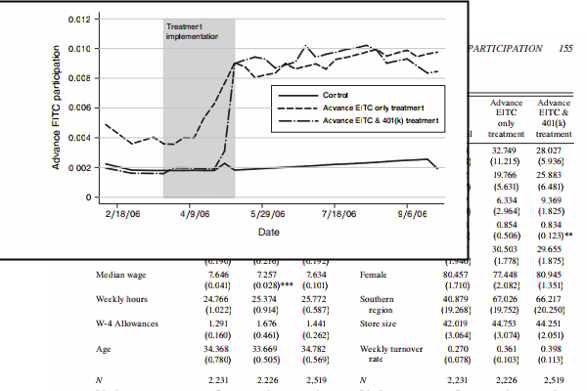
Analysis in Economics

Slide 50
Wide use of public-use data
Macrodata:
“We use data downloaded from the Bureau of Economic Analysis…”
Microdata:
“… this paper uses data from the Current Population Survey…”

Slide 51
Positive attitudes?
Often liberal sharing of data and code (via email, networks)
Sharing of articles prior to publication (RePEc)

Slide 52
And yet, there are issues

Slide 53
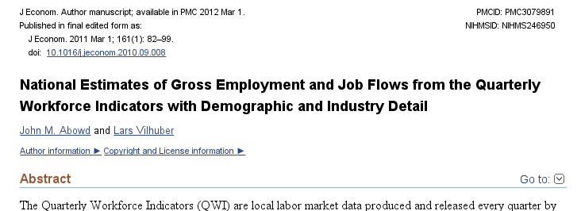
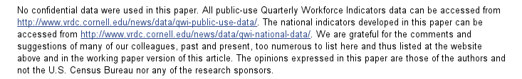
An example

Slide 54
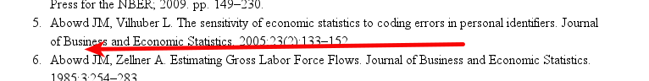
An example: not cited…

Slide 55
Data not attached to article
J of Econometrics Data Policy at the time could not accommodate 50MB file
Data was not attached to paper.
Today’s J of Econometrics policy suggests using third-party repositories
We will get to that later

Slide 56
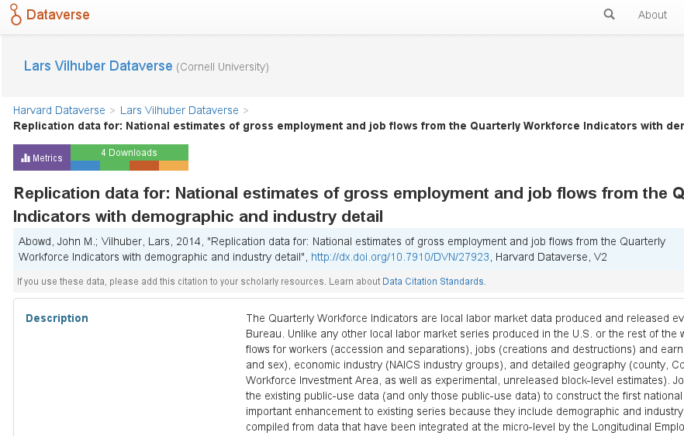
We went back, archived it

Slide 57
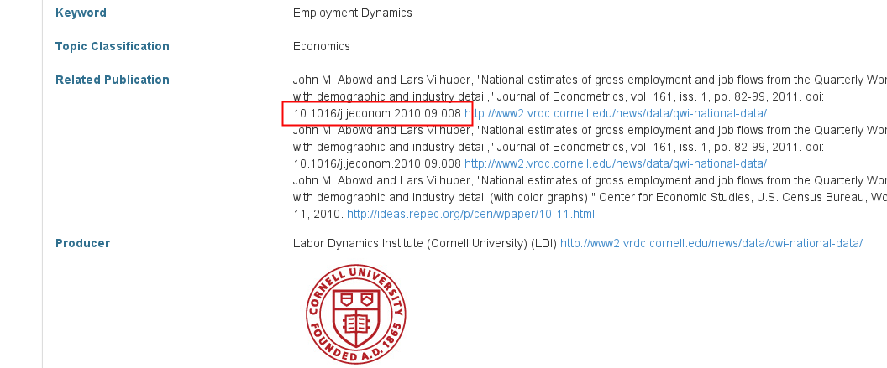
We went back, archived it, linked it back

Slide 58
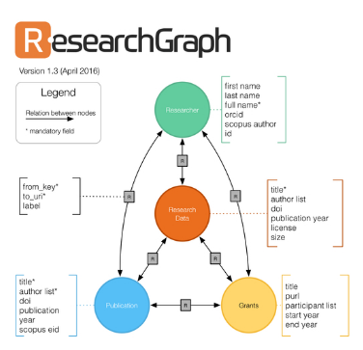


But journal and data infrastructure are incomplete
While Dataverse allows to manually link back…
… the article itself reveals none of that
True for most journals, and most data archives
ICPSR (manual linking to articles)
RePEc (no linkage possible)
Infrastructure starting to emerge
If article cites data (DOI!)
If archive and/or journal leverages infrastructure

Slide 59
Using personal websites
Don’t even think about using personal websites!

Slide 60
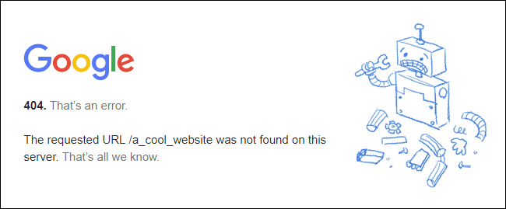

Slide 61

source

Slide 62
Yielding to the temptation of “administrative”data
State-level data
“Our analysis draws on administrative records from the Detroit Work First program linked with unemployment insurance (UI) wage records for the State of Michigan”
Autor/Houseman doi:10.1257/app.2.3.96
School-district data
“confidential student-level panel dataset provided by the School Board of Alachua County in Florida”
Carrel and Hoekstra doi:10.1257/app.2.1.211

Slide 63
… yielding…
Proprietary data
“This field experiment was made possible by the collaboration of a large-scale, nationwide firm in the retail sector. ”
Damon doi:10.1257/app.2.2.147

Slide 64
Death Knell for Public-use Data?
Sounded by young scholars pursuing research programs that mandate inherently identifiable data:
Geospatial relations,
Exact genome data,
Networks of all sorts,
Linked administrative records
These researchers acquire authorized, generally unfettered, restricted access to the confidential, identifiable data and perform their analyses in secure environments.
But: generally don’t leave behind the scientific trail that has made public-use files so important.

Slide 65


Slide 66
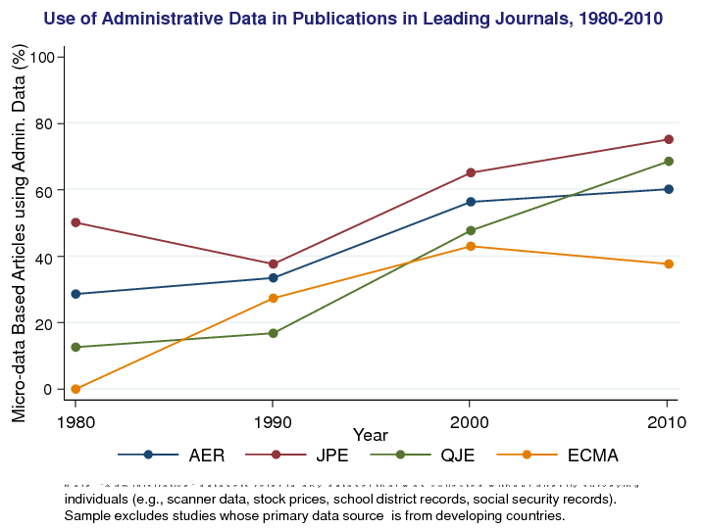

Slide 67
Progress in Economics

Slide 68
Increasing transparency in economics journals
Econometrica
“ the original raw data will, as a rule, be published, unless their volume is excessive”
1933

Slide 69
Increasing transparency in economics journals
Journal of Political Economy
“ Confirmations and Contradictions” Section
1976-1999

Slide 70
Increasing transparency in economics journals
Journal of Money, Credit & Banking
Data and Code requested upon submission
1982

Slide 71
Increasing transparency in economics journals
American Economic Association
Data and code availability policies
2005

Slide 72
Increasing transparency in economics journals
Promoting Transparency in Social Sciences Miguel et al (Science) 10.1126/science.1245317
2014
Greater transparency
Registration and pre-analysis plans
Open data and materials

Slide 73
Increasing transparency in economics journals
Quarterly Journal of Economics
Data and code availability policies

Slide 74
Explicit replication remains rare

Slide 75
How common is replication in economics?
0.1% of 126,505 “top 50” published articles 1974-2014 are replications – Mueller-Langer et al. (2018)
6.2% of 1,138 “top 10” development articles 2000-2015 were subjects of replications - Sukhtankar (2017)

Slide 76
Replications and Reproducibility Checks Remain Rare
No significant replication journal
ReplicationWiki identifies 44 “Comments” in the AER as “replications” of some sort, out of ~200*13 = 2600 articles (2004-2016) = 1.7%

Slide 77
Explicit replication remains rare
Or are they?

Slide 78
“Dark Web” of Replications
Personal communication: lots of micro, labor, macro Ph.D. classes have students run (successful) replications
Hamermesh (2007): papers that do not replicate do not get cited (… over time)
Projects (…) to provide replications (in the broad sense) by “swapping country”
(Do the results of Paper A – run on data from country B – work in country C)

Slide 79
Explicit Replications and Reproduction Attempts
Vary in how they assess the exercise
Replication or Reproducibility
Denominator: Data available, or all articles? Prevalence of restricted-access data!
Numerator: Partial or full reproduction/ replication? Who makes the assessment? How?
Quantity/ domain

Slide 80
Some key statistics
Study | Year | N | Success | Type | Type-R | Type-Data | Percent | Field
Dewald Thursby Anderson | 1986 | 54 | 2 | Complete | Reproducibility | Avail | 4% | Economics
Dewald Thursby Anderson | 1986 | 54 | 7 | Partial | Reproducibility | Avail | 13% | Economics
McCullough McGeary Harrison | 2006 | 186 | 14 | Complete | Reproducibility | All | 8% | Economics
McCullough McGeary Harrison | 2006 | 62 | 14 | Complete | Reproducibility | Avail | 23% | Economics
Nosek et al | 2015 | 100 | 36 | Complete | Replication |  | 36% | Psychology
Camerer et al | 2016 | 18 | 11 | Complete | Replication |  | 61% | Experimental Econ
Chang Li | 2017 | 67 | 22 | Complete | Reproducibility | Avail | 33% | Macroeconomics
Kingi et al | 2018 | 274 | 69 | Complete | Reproducibility | All | 25% | Economics
Kingi et al | 2018 | 162 | 69 | Complete | Reproducibility | Avail | 43% | Economics
Kingi et al | 2018 | 162 | 137 | Partial | Reproducibility | Avail | 85% | Economics

Slide 81
Some key statistics

Slide 82
What are we doing in Economics?
Socialscienceregistry.com (J-PAL initiated, taken over by AEA)
Broad spectrum of studies – experimental, RCT, big data, theory, simulations
Broad acceptance of data availability policies at the top journals, less so below (study)
Heterogeneous inclusion in teaching (range of computer literacy is wide), no standard workflow

Slide 83
Current efforts at the AEA

Slide 84
What are we doing at the AEA?
(cite from annual report)
Tools, training, visibility, transparency, awareness

Slide 85
Remember this?

Slide 86
Method

Slide 87

Undergraduate Summer Research Assistants
2014 - 2018

Slide 88
Undergraduate Summer Research Assistants
2014 - 2018
Economics
Comp Sci.
OpRe

Slide 89
Undergraduate Summer Research Assistants
2014 - 2018
Economics
Comp Sci.
OpRe
Reproduction
VCS
Cloud Computing

Slide 90

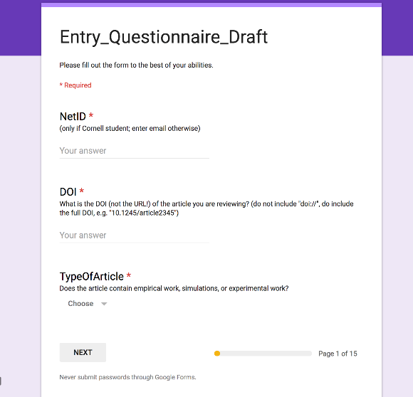
Method
Assessment Form

Slide 91

Method
Assessment Form
Reproduction Exercise

Slide 92

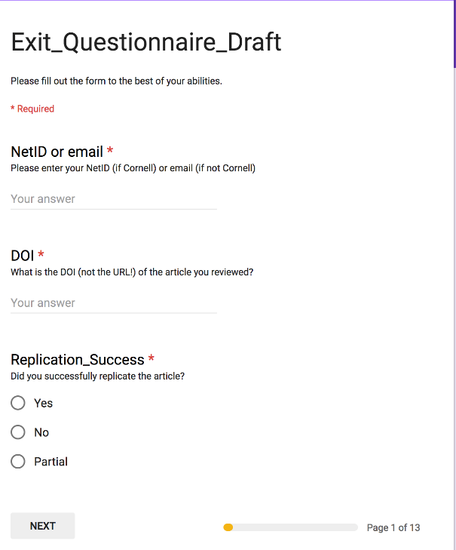
Method
Assessment Form
Reproduction Exercise
Exit Questionnaire

Slide 93
Replication continuum
Our Focus
08
Reproducibility
Replicability
Generalizability
Narrow Replication (Pesaran 2003)
Pure Replication (Hamermesh 2007)
Verification (Clemens 2015)
Wide Replication (Pesaran 2003)
Statistical Replication (Hamermesh 2007)
Reproduction/Reanalysis (Clemens 2015)
Wider Replication (Pesaran 2003)
Scientific Replication (Hamermesh 2007)
Reanalysis/Robustness (Clemens 2015)

Slide 94
Replication continuum
Same data | Same code | Same methods | Same context
08
08
08
Reproducibility
Replicability
Generalizability
Narrow Replication (Pesaran 2003)
Pure Replication (Hamermesh 2007)
Verification (Clemens 2015)
Wide Replication (Pesaran 2003)
Statistical Replication (Hamermesh 2007)
Reproduction/Reanalysis (Clemens 2015)
Wider Replication (Pesaran 2003)
Scientific Replication (Hamermesh 2007)
Reanalysis/Robustness (Clemens 2015)

Slide 95


Slide 96
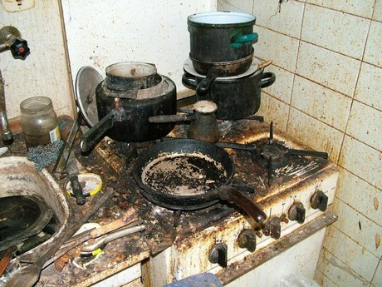

Slide 97
From Post- to Pre-Publication Verification
Cornell Replication Lab has been verifying published articles
Now switching to manuscripts in the submission workflow
For now pilot
Authors have submitted prior to announcement of new data policy

Slide 98
Email during pilot phase
Dear [AUTHOR]: I am writing about your paper [MC ID]. I am ready to give you a "conditional accept" on the paper. The condition is simply to work with the AEA's data co-editor, Lars Vilhuber (copied on this email), to prepare the data and code for publication. The data is an important contribution of the paper. He is copied on this email. Thank you for submitting your work. I am looking forward to seeing the paper in print.

Slide 99
Future efforts
AEA, Social Sciences, elsewhere

Slide 100
Evolving Journal and Data Infrastructure
More self-deposit repositories in the social sciences
Dataverse
Figshare
openICPSR
Zenodo
Qualitative Data Repository (QDR)
Others…

Slide 101
More and easier data deposit
More integration into Journal Workflows
AJPS + Dataverse
QJE, Restat (both Harvard…) + Dataverse
Data deposit occurring during submission

Slide 102
At the AEA…
We will create a journal-specific repository for AEA journals
Open for deposit 2019 Q1
We will migrate all historical supplements to the archive
Explode the ZIP files: greater transparency

Slide 103
And then we’ll kill it

Slide 104
Let me explain…

Slide 105
What are we going to do at the AEA?
Long-term outlook
Challenges: firm data – how to move as close as possible to the ideal of full provenance traceability
Pre-registration: highlighting
Registered reports? JDE only so far (see Frankel and Kasy, 2018, Which findings should be published for a nuanced model and view)

Slide 106
Remember this figure?

Slide 107
Assessing accessibility
Chetty’s assessment was entirely manual
Download the article
Read what kind of data is used
And yet does not provide information such as
Who can access?
How long can you access?
Characteristics of the data
… and not for want of trying, but because that information is not required and not provided

Slide 108
From earlier examples
Costly access but good intentions:
“researchers could submit programs that [...] research assistants would run. Alternatively, researchers wishing to work directly with the data could come and work on the Institute's premises.” Autor/Houseman doi:10.1257/app.2.3.96
Uncertain access
“Data [...] is proprietary and owned by the Alachua County, Florida School District. The corresponding author [...] holds the deidentified dataset [...] and will provide copies to authors who receive written permission from the Alachua County Public Schools.”

Slide 109
Current Data Availability Policies are Broken
If the Data is not open-access, no systematic information is collected (“exemption”)

Slide 110
Current Data Availability Policies are Broken
If the Data is not open-access, even if the Data Owner has already deposited it

Slide 111
Current Data Availability Policies are Broken
If the Data is open-access, you are asked to deposit the data in the “journal repository” even if the Data Owner has already deposited it

Slide 112
Current Data Availability Policies are Broken
If the Data is open-access, you are asked to deposit the data in the “journal repository” even if you have followed best practices and have already deposited it

Slide 113
Illustration
If you used the ACS, should you deposit it again?

Slide 114
Illustration
If you used the LEHD, has the Census Bureau not already archived it?

Slide 115
Illustration
If you used the LEHD, can others not access it?

Slide 116
Illustration
If you used files at the National Archives, are they not already archived?

Slide 117
Best practices
Deposit and archive early
If you collect data, archive it (possibly privately)
If you finish the manuscript, deposit the analysis files (possibly privately)

Slide 118
Best practices
Follow robust coding
Ensure that code reliably produces results (possibly automated)
Before you finish the manuscript, run all analysis code again (if not too onerous)

Slide 119
The goal at the AEA
Ensure reproducibility of computational code
Encourage best practices
Not require double-work
If you have deposited your work (in a reliable location), leave it there
If you have had your code verified (by a reliable third party), we will accept that

Slide 120
Ensuring scalable reproducibility

Slide 121
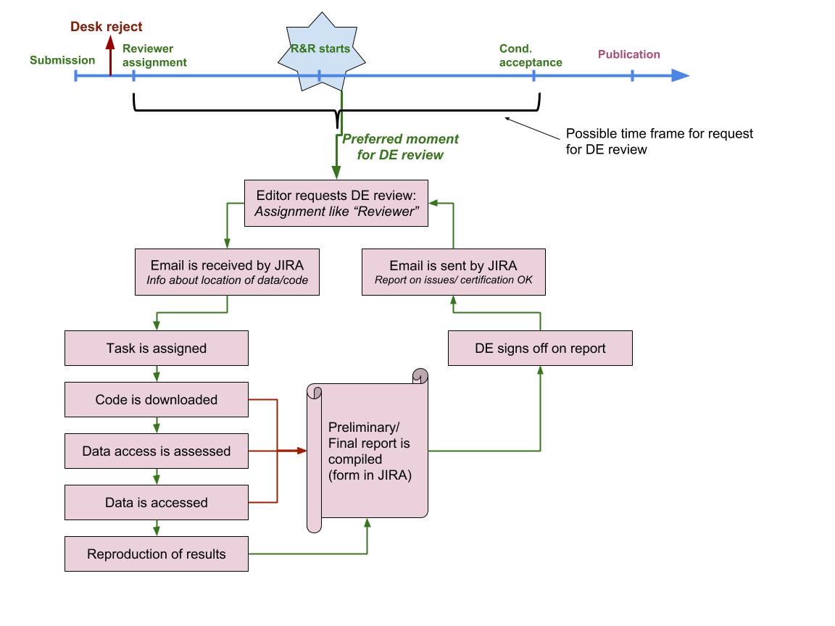

Slide 122
New AEA Data and Code Availability Policy
Dear [AUTHOR]: I am writing about your paper [MC ID]. I am ready to give you a "conditional accept" on the paper. The condition is simply to work with the AEA's data co-editor, Lars Vilhuber (copied on this email), to prepare the data and code for publication. The data is an important contribution of the paper. Thank you for submitting your work. I am looking forward to seeing the paper in print.

Slide 123
New AEA Data and Code Availability Policy
Dear [AUTHOR]: I am writing about your paper [MC ID]. I have received two referee reports, which you will find attached. We would like you to revise and resubmit your paper. […] As you revise the paper, please also work with the AEA's data co-editor, Lars Vilhuber (copied on this email), to document and verify the reproducibility of the data and code. The data is an important contribution of the paper. Thank you for submitting your work. I am looking forward to seeing the revised paper.

Slide 124
Policy A.2 | Policy B
Data Availability Policy | Data and Code Availability Policy
It is the policy of the American Economic Association to publish papers only if | It is the policy of the American Economic Association to publish papers only if
the data used in the analysis are clearly and precisely documented | the data and code used in the analysis are clearly and precisely documented;
and are readily available to any researcher for purposes of replication. | access to the data and code is clearly and precisely documented, and is non-exclusive to the authors.
Authors of accepted papers that contain empirical work, simulations, or experimental work must provide, | Authors of accepted papers that contain empirical work, simulations, or experimental work must provide,
prior to publication, | prior to acceptance,
the data, programs, and other details of the computations sufficient to permit replication. | information about the data, programs, and other details of the computations sufficient to permit replication, as well as information about access to data and programs.
These will be posted on the AEA Data and Code Repository at TBD. | Data and programs should be archived in community-recognized or general repositories, including the AEA Data and Code Repository at TBD.
 | Authors will provide access to editors and reviewers, if requested, to both data and programs prior to acceptance.
The Editor should be notified at the time of submission if the data used in a paper are proprietary or if, for some other reason, the requirements above cannot be met. | The Editor should be notified at the time of submission if access to the data used in a paper is restricted or limited, or if, for some other reason, the requirements above cannot be met.
The AEA Data Editor will assess compliance with this policy. | The AEA Data Editor will assess compliance with this policy,
 | and will verify the accuracy of the information prior to acceptance by the Editor.
 | A statement describing compliance with this policy will be posted alongside the article.

Slide 125
Policy A.2 | Policy B
Data Availability Policy | Data and Code Availability Policy
It is the policy of the American Economic Association to publish papers only if | It is the policy of the American Economic Association to publish papers only if
the data used in the analysis are clearly and precisely documented | the data and code used in the analysis are clearly and precisely documented;
and are readily available to any researcher for purposes of replication. | access to the data and code is clearly and precisely documented, and is non-exclusive to the authors.
Authors of accepted papers that contain empirical work, simulations, or experimental work must provide, | Authors of accepted papers that contain empirical work, simulations, or experimental work must provide,
prior to publication, | prior to acceptance,
the data, programs, and other details of the computations sufficient to permit replication. | information about the data, programs, and other details of the computations sufficient to permit replication, as well as information about access to data and programs.
These will be posted on the AEA Data and Code Repository at TBD. | Data and programs should be archived in community-recognized or general repositories, including the AEA Data and Code Repository at TBD.
 | Authors will provide access to editors and reviewers, if requested, to both data and programs prior to acceptance.
The Editor should be notified at the time of submission if the data used in a paper are proprietary or if, for some other reason, the requirements above cannot be met. | The Editor should be notified at the time of submission if access to the data used in a paper is restricted or limited, or if, for some other reason, the requirements above cannot be met.
The AEA Data Editor will assess compliance with this policy. | The AEA Data Editor will assess compliance with this policy,
 | and will verify the accuracy of the information prior to acceptance by the Editor.
 | A statement describing compliance with this policy will be posted alongside the article.

Slide 126
Policy A.2 | Policy B
Data Availability Policy | Data and Code Availability Policy
It is the policy of the American Economic Association to publish papers only if | It is the policy of the American Economic Association to publish papers only if
the data used in the analysis are clearly and precisely documented | the data and code used in the analysis are clearly and precisely documented;
and are readily available to any researcher for purposes of replication. | access to the data and code is clearly and precisely documented, and is non-exclusive to the authors.
Authors of accepted papers that contain empirical work, simulations, or experimental work must provide, | Authors of accepted papers that contain empirical work, simulations, or experimental work must provide,
prior to publication, | prior to acceptance,
the data, programs, and other details of the computations sufficient to permit replication. | information about the data, programs, and other details of the computations sufficient to permit replication, as well as information about access to data and programs.
These will be posted on the AEA Data and Code Repository at TBD. | Data and programs should be archived in community-recognized or general repositories, including the AEA Data and Code Repository at TBD.
 | Authors will provide access to editors and reviewers, if requested, to both data and programs prior to acceptance.
The Editor should be notified at the time of submission if the data used in a paper are proprietary or if, for some other reason, the requirements above cannot be met. | The Editor should be notified at the time of submission if access to the data used in a paper is restricted or limited, or if, for some other reason, the requirements above cannot be met.
The AEA Data Editor will assess compliance with this policy. | The AEA Data Editor will assess compliance with this policy,
 | and will verify the accuracy of the information prior to acceptance by the Editor.
 | A statement describing compliance with this policy will be posted alongside the article.

Slide 127
Goal: earlier provision of data and code
“Arguably, the replication files should be submitted when the paper is initially submitted so that they will be available for inspection by the referees, if the referees so desire.”
(McCullough et al, 2006)

Slide 128
Scalability and sustainability

Slide 129
Scalability of Verification
500+ articles per year at AEA (not all have code or data)
Financing:
$100 submission fee minus $100 per referee report (x2)
Undergraduate student (~$15/h) spends 10-20 hours on most verifications (would be far less if automated) = $200 extra
Most journals are run at a loss (but maybe Elsevier has the funds…)

Slide 130
Scalability of Verification
Third party verification services already exist!
For research institutes and groupings (J-PAL, NBER, etc.)
At universities (Cornell, etc.)
Because authors already do it
Even at restricted-access centers
Explicitly: France
Implicitly: German IAB data, other restricted-access data (remote processing at NCHS, Statistics Canada)
Interest in other institutions (including Census Bureau)

Slide 131
Scalability of Verification
Third party verification
How to fund
similar to open-access submission fees?
Requirement by funders?
How to certify third-party certifiers?
How reliable is their service? What do they check?
Who certifies? (Association of Data Editors?)
These are open questions
They need to be solved for persistence of the effort

Slide 132
Verifying Data and Code Deposits
Why do journals like affiliated repositories (or website deposits)?
They can ensure longevity/ persistence
They can ensure access
They can ensure availability

Slide 133
Verifying Data and Code Deposits
Not every data repository is created equal
Github, Dropbox, etc. are not data or code repositories
Is the institutional repository at the University of Southern Venezuela a reliable repository?
Is the institutional repository at Cornell University a reliable repository?
Is the institutional repository at Harvard University (Dataverse!) a reliable repository?
Are the National Archives a reliable repository?

Slide 134
Verifying Data and Code Deposits
Not every data repository is created equal
The Second Bank of Third City credit card data is not a data/code repository
Is the School Board of Third City a reliable repository?
Is the JPMC Institute a reliable repository?
Is the US Census Bureau a reliable repository?
Are any restriced-access repositories a reliable repository?

Slide 135
Linking objects (data, programs), articles and researchers
Reminder: currently a very manual process
Only really works if the article cites the data
Infrastructure starting to emerge
If article cites data (DOI!)
If archive and/or journal leverages infrastructure

Slide 136
AEA: improve transparency of all data deposits
Developed a schema to collect relevant information
Relies as much as possible on lookups of existing data
Collects only as much information as necessary
Replaces existing documentation efforts
Can be done early in research workflow

Slide 137
AEA: improve transparency of all data deposits
Developed a schema to collect relevant information
Uniformly applied to public-use and restricted-access data
Can be added at low-cost to existing journal websites
Can be data-mined

Slide 138
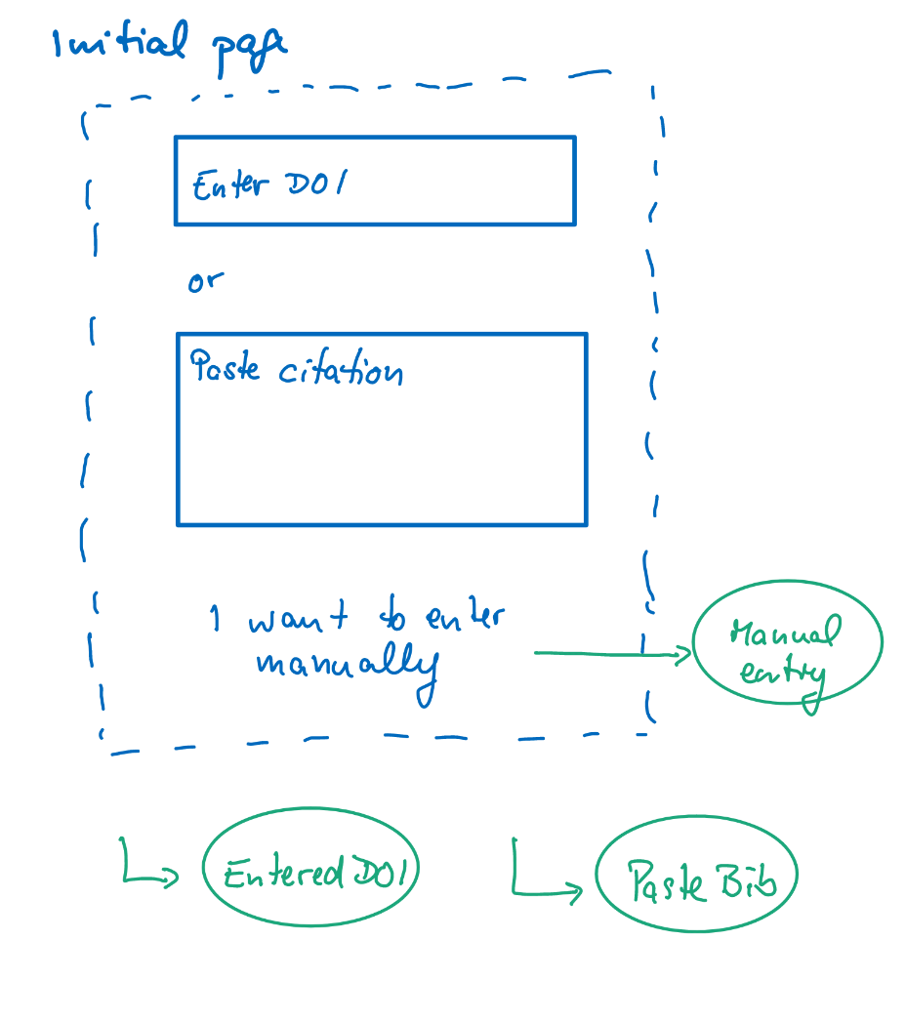
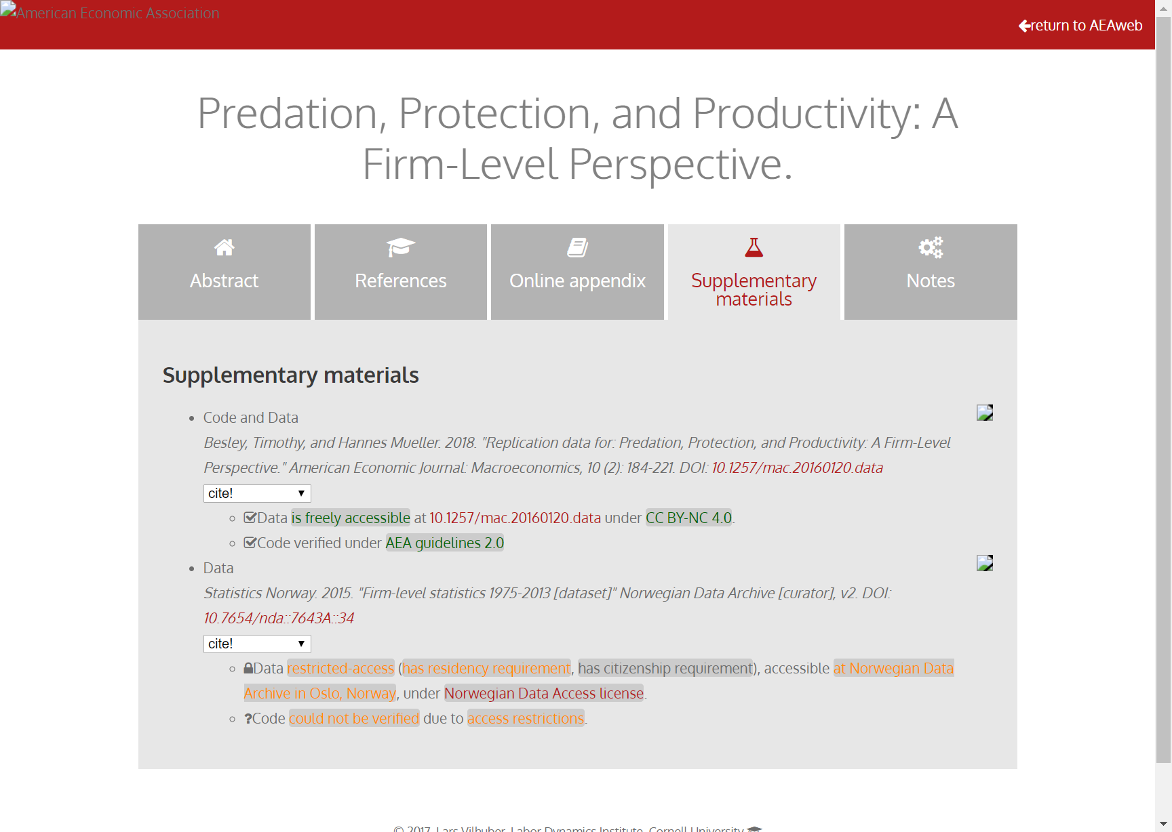
Richer metadata, more transparency

Slide 139
Richer metadata, more transparency

Slide 140
New problem: Licensing of code and data
Do you know what license your journal supplements are under?

Slide 141
Really brief licensing primer
Software licenses:
Copyright
protecting yourself from being held liable
US: copyright is automatic
if you don’t choose a license for your software, no one else can use it!
Journals: Usually acquire copyright
Most likely, you also assigned the copyright to the supplement to the journal!
Source: http://kbroman.org/steps2rr/pages/licenses.html

Slide 142
Did you know?
The AEA acquired the copyright to the supplements when you assigned the article copyright
The AEA did not grant a default license
Thus, all replication and reproduction attempts are infringing on the AEA’s copyright!
We’re fixing that…

Slide 143
Best practices in licensing
Data: Creative Commons Attribution (CC-BY) and variants
Non-commercial (NC)
Share-alike (SA)
Code: various Open Source licenses
GPL: GNU Public License (restrictive)
MIT or (modified) BSD license (less restrictive)

Slide 144
Other initiatives

Slide 145



Center for Open Science Badges
https://cos.io/our-services/open-science-badges/; 53 adopting journals (18 as of 2017)
Kidwell et al., 2016
Notes:
Badges
Open Data
Open Materials
Preregistration
Psychological Science (Jan 2014)

Slide 146
40%
30%
% Articles reporting data available in repository
20%
10%
0%

Slide 147
Signals? Badges? Transparency!
Positives:
Give credit for previously invisible activities
Can be assessed quickly
Negatives:
Need to be known in order to be effective
May bias outcomes!
Require effort for verification?

Slide 148
Example: COS disclosures
Open Data: Authors complete two disclosure items for each Open Data badge application:
Provide the URL, DOI, or other permanent path for accessing the data in a public, open access repository.
How do I know it is open access? Verify!
How do I know the data is permanent? Verify?
What do I do when access is possible, but not open access?

Slide 149
Example: COS disclosures
Open Data: Authors complete two disclosure items for each Open Data badge application:
Is there sufficient information for an independent researcher to reproduce the reported results? If no, explain.
All researchers claim the information is sufficient -> our results

Slide 150
Example: COS disclosures
Open Materials: Authors complete two disclosure items for each Open Materials badge application:
Provide the URL, DOI, or other permanent path for accessing the materials in a public, open access repository.
Is there sufficient information for an independent researcher to reproduce the reported methodology? If no, explain.
Similar concerns as before

Slide 151
Pre-registration

Slide 152
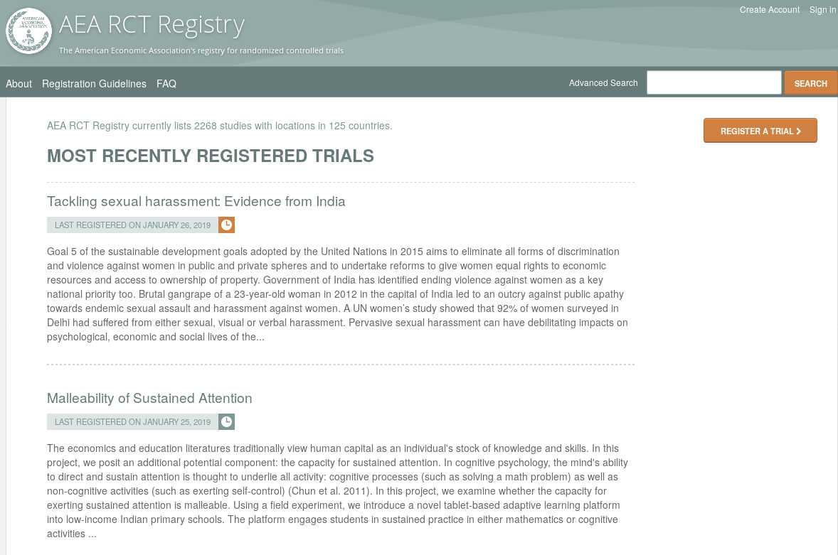
Preregistration

Slide 153
Preregistration

Slide 154
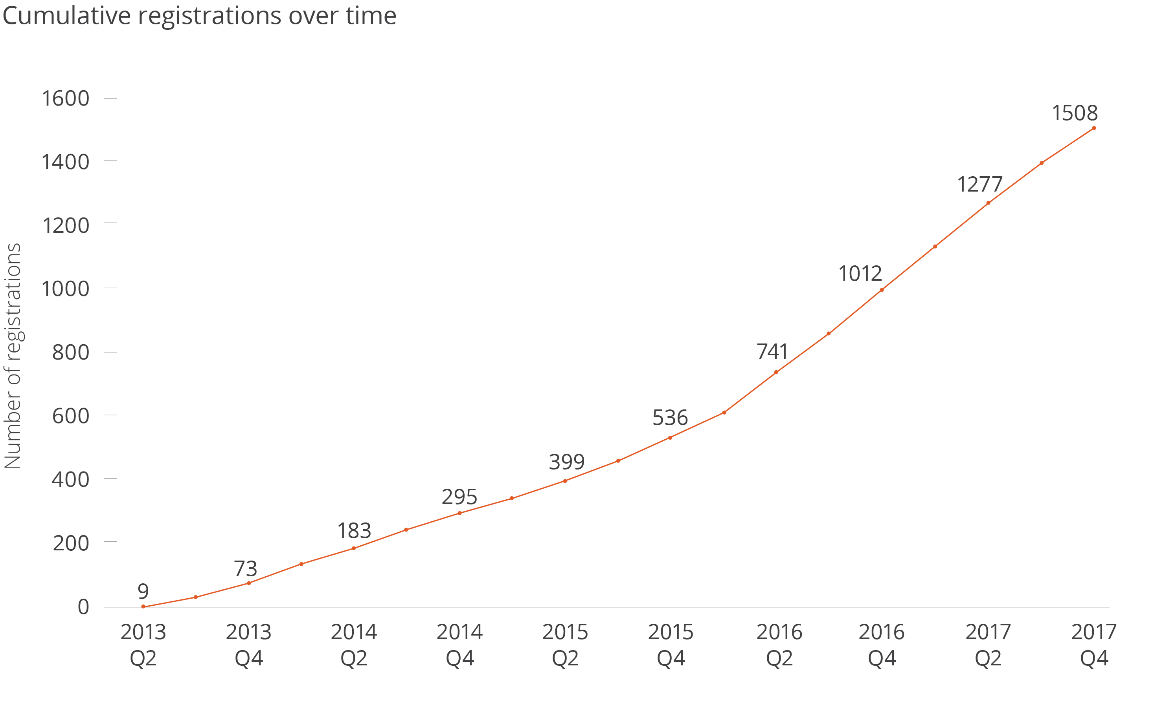
Registrations at the AEA Registry

Slide 155
Plans at the AEA
Integrate registrations more robustly
Cite through DOI
Link more robustly (not just citation!)
Highlight through badges?

Slide 156

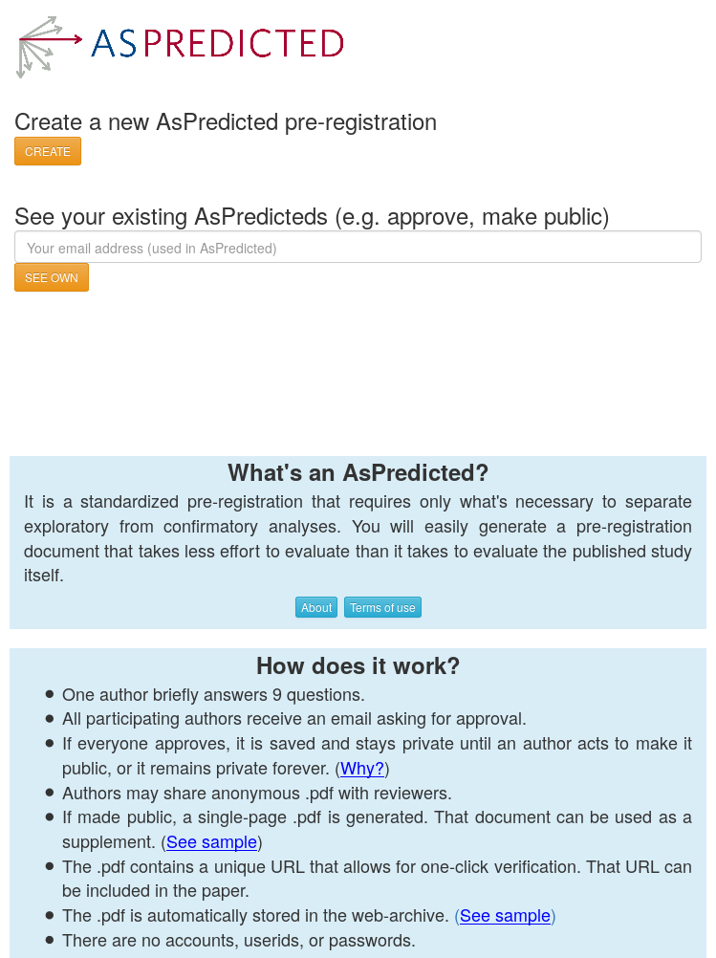
Plans at the AEA
Not just the AEA Registry
OSF registrations
Int’l Initiative for Impact Evaluation (3ie)’s RIDIE registry
Evidence in Governance And Politics (EGAP)’s registry
As-Predicted

Slide 157
Registered Reports

Slide 158
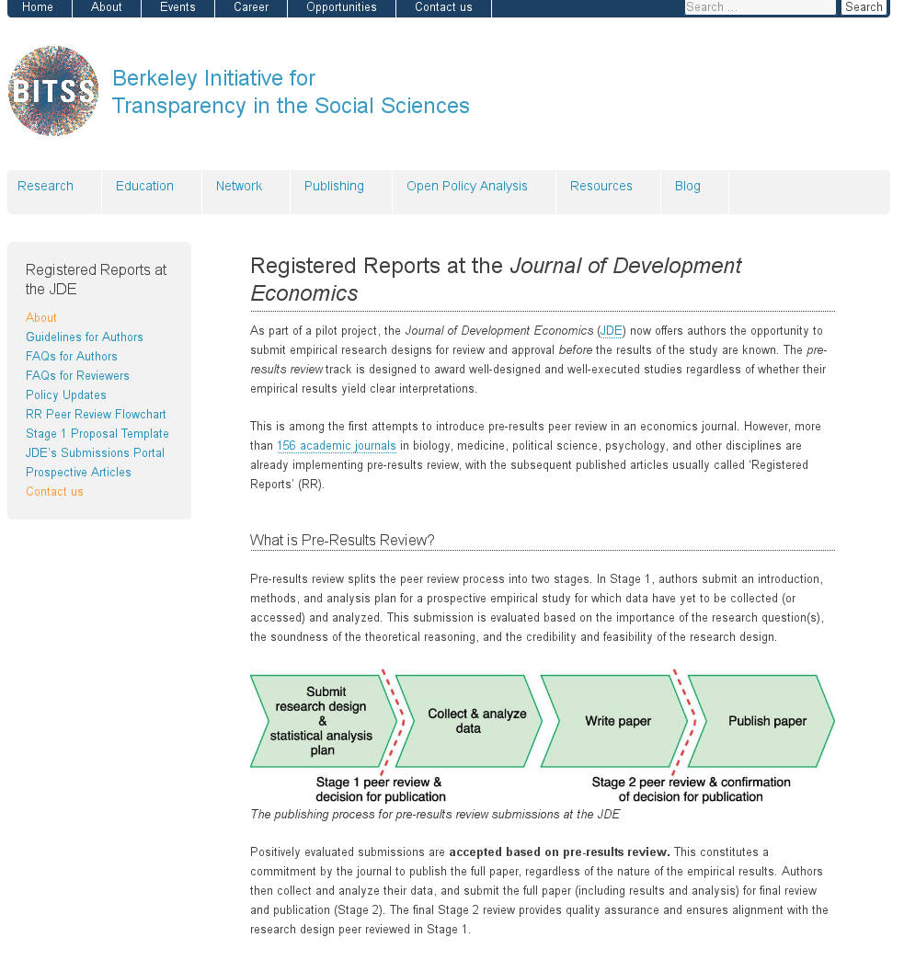
Registered Reports

Slide 159
Registered Reports

Slide 160
Your turn!

Slide 161
What will you be doing going forward?
Who has shared code and data?
Who has done so when not required?
Pre-registration

Slide 162
Sharing of code and data is coming
Are you ready?

Slide 163
New skills (to learn, to teach)
How to incorporate reproducible practices into your workflow
How to structure your code and your data with an eye on reproducibility
How to license your contributions!
When to pre-register, and when not to
Document early, and often

Slide 164
It is good practice
Hamermesh (2007) already said:
“the payoff is in the influence of one’s ideas: having other scholars base their work on those ideas, having students learn from them, and […] having public policy influenced by them […] our ideas are unlikely to be taken seriously if our empirical research is not credible”

Slide 166
Preservation

Slide 167
Replicability in historic context

Slide 168
Replicability in historic context
How to establish provenance of results
Citing
Books
Tables in compendia
Statistical handbooks
Math done by hand!
Much use of public statistics

Slide 169
Long drought?
Return to this topic
Dewald Thursby Anderson, AER 1986 (policy at JMCB)
Implementation of data availability policy at AEA (2003/2005)
McCullough McGeary Harrison, JMCB 2006

Slide 170
Definitions

Slide 171
Replicability and Reproducibility
Bollen et al (2015), NSF Report
Reproducibility (“narrow” in J Appl Econometrics, “pure replication” Hamermesh (2007), sometimes called “replicability”)
Same data, same code
[Programming] aspects of a “unit test”
Replicability (“wide” in J Appl Econometrics, “scientific replication” Hamermesh (2007), sometimes called “reproducibility”)
Different data and/or
Different implementation and/or
Different assumptions?

Slide 172
Purpose of replication archives
To be able to verify that the “recipe” did produce the results published (log)
To be able to verify that the “recipe” can be used by others to produce the same results (reproducibility)
To allow others to leverage and to build on prior work (re-use, efficiency)
“threat of replication provides an incentive for careful empirical research” (MMH)

Slide 173
Key ingredients
Clear data provenance
Accessible data
Well-structured, comprehensible, functioning programs
Available without any additional information or help from the authors

Slide 174
Problems… old

Slide 175
Some key statistics
Authors | Year | Replication success | Field
Dewald Thursby Anderson | 1986 | 2/54 = 3.7% | Economics
McCullough McGeary Harrison | 2006 | 14/62 = 22% or 14/186 = 7.5% | Economics

Slide 176
Requesting copies of code
Authors | Year | Success (=response received) | Field
Dewald Thursby Anderson | 1986 | 22/62= 35.5% | Economics

Slide 177
Moving forward?

Slide 178
A new world?
2003/2005 Data availability policy of the American Economic Association:
It is the policy of the American Economic Association to publish papers only if the data used in the analysis are clearly and precisely documented and are readily available to any researcher for purposes of replication.

Slide 179
Variations
AEJ: Insights (new):
… all data used in your analysis should be clearly and precisely documented and should be made available on the journal's website for purposes of replication

Slide 180
In practice
Data and code archive provided as supplementary online materials
Single ZIP file on journal’s website
may contain data
may contain code
Should always contain a “readme” file describing what to do in order to leverage code and data to create
the paper’s tables as published
the paper’s figures as published
any in-text results (less frequent!)

Slide 181
Requesting copies of code
Authors | Year | Success (=response received) | Field
Dewald Thursby Anderson | 1986 | 22/62= 35.5% | Economics
Chang Li | 2017 | 11/26 = 42% | Macroeconomics
Our analysis (Kingi et al) | 2017 | 48/117 = 41% (materials: 12) | Specific journal

Slide 182
A glimpse into the future

Slide 183

Ongoing elsewhere
Journals
have implemented verification of submitted code and data during the editorial process (AJPS with Odun Institute; JASA)
highlight data and code access criteria (badges: OSF)
maintain lists of acceptable third-party repositories (and embed some of those within the submission workflow) (Nature, CoreTrustSeal)
interlink with collaborating repositories to highlight authors' (and repositories') contributions to the data component of a scholarly work (Elsevier + ICPSR)

Slide 184
Ongoing elsewhere
Services
For free or low-cost archiving
(openICSPR, Zenodo, figshare, dryad, Dataverse)
Online computational capsules
CodeOcean (object includes OS, verification)
(note: I did not include Github, Gitlab, etc. – on purpose)

Slide 185
Still early
Badges are visual help, but not robust yet (subject to changes, do not cover all situations)
Verification can be time-consuming / costly (but see some natural sciences)
List of repositories differ across journals/ providers/ central registries (OSF, Nature, re3data, Fairsharing: which is “right”? What are the criteria?)

Slide 186
And then there was….

Slide 187
Confidential data

Slide 188
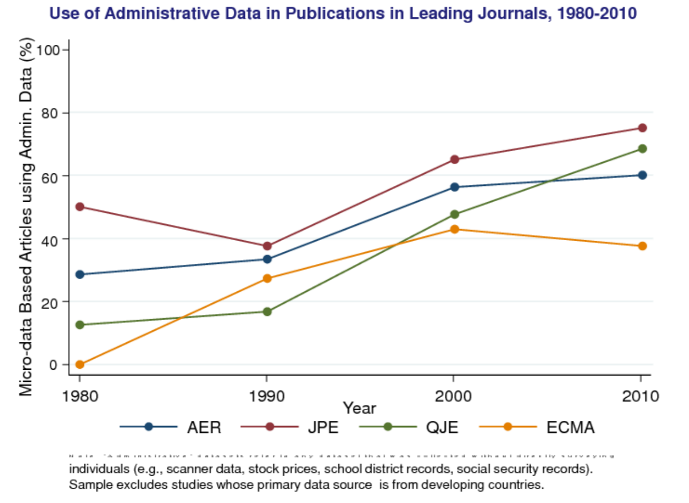
Use of admin data (Chetty)

Slide 189
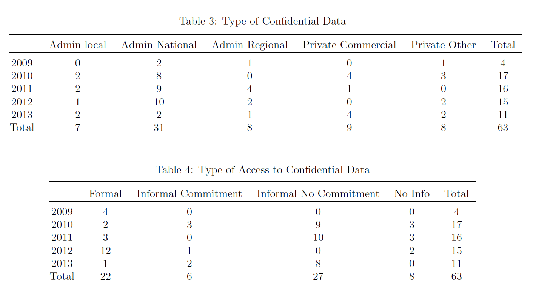
Number of papers with “proprietary” data
/8
/35
/36
/40
/38
/157

Slide 190
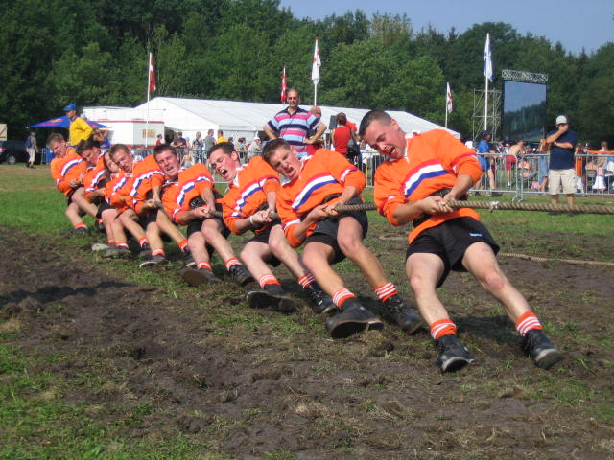
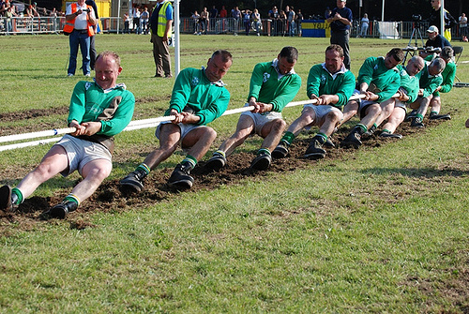
Confidentiality and Accessibility
Confidential
data
Confidentiality
Accessibility

Slide 191
Types of data access
Proprietary: often meant for all restricted-access, more narrowly for commercial data
Confidential: for any number of reasons, data cannot be anonymized without affecting the statistical validity of the data and the results
Licensed data: data which is subject to conditions (use, access, redistribution)
Open-access data: often used for “free” or “unencumbered” data

Slide 192
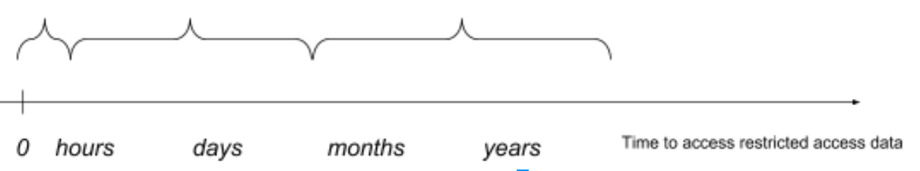
Alternate view
OA
Licensed data
Confidential data

Slide 193
Black Box problem
We have less insight into the “proprietary” data papers
Less success in “help by authors” in general
Information problem

Slide 194

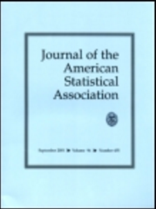
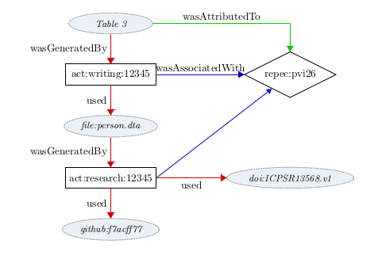
Replicability in RADEs
Replicability is a problem
Cannot be satisfied with idiosyncratic access mechanisms
Some research with confidential files could lose (reputable) publication outlets
Transparency critical
Need capability to be able to archive research files within secure enclaves
Need ability to publically identify such files (documentation) [DDI, DOI]

Slide 195
Making data (more) accessible
Making data (more) accessible
National Data Bank
1959-1965
National Data Bank (1965)
“Recommendations on Availability of Federal Statistical Materials to Nongovernmental Research Workers”
“Recommendations on Availability of Federal Statistical Materials to Nongovernmental Research Workers”
(1959)
Committee on the Preservation and Use of Economic Data
Committee on the Preservation and Use of Economic Data
(1965)
Src: Kraus (2013)
Notes:
All of these types of questions and topics have been brought up before, more than 50 years ago.

Slide 196

researchers knocking on the door

Slide 197
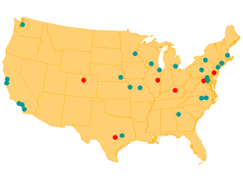
RADEs in the US
Starting in the 1960s and 70s, increased use of public-use microdata samples and surveys
Researcher access at Census Bureau headquarters in the 1970s
1990: [Computing power: 3.5 MFLOPS for $9000]
First RDC at Boston in the 1994
A small number of RDCs in the 1990s
Thin clients in the 2000s
2018: 31 RDCs
Notes:
… and so they keep knocking on the door

Slide 198
RADEs: Germany
Institute for Employment Research (IAB), Germany
Commission to improve the informational infrastructure between the scientific community and official statistics
recommended creation of RDCs by producers of microdata (2001)
RDC created in 2004 for “weakly anonymous” data
Scientific use files (factually anonymous data) available under licensing agreements to university data enclaves
2011 RDC created at University of Michigan (with NSF funding)
(KVI)
1902
1942
1960
1985
today
2001
2004
2011
15 RDCs in 3 countries
Notes:
I‘m only going to focus on a few other countries that demonstrate some of the features I want to highlight
Kommission zur Verbesserung der informationellen Infrastruktur zwischen Wissenschaft und Statistik, KVI

Slide 199
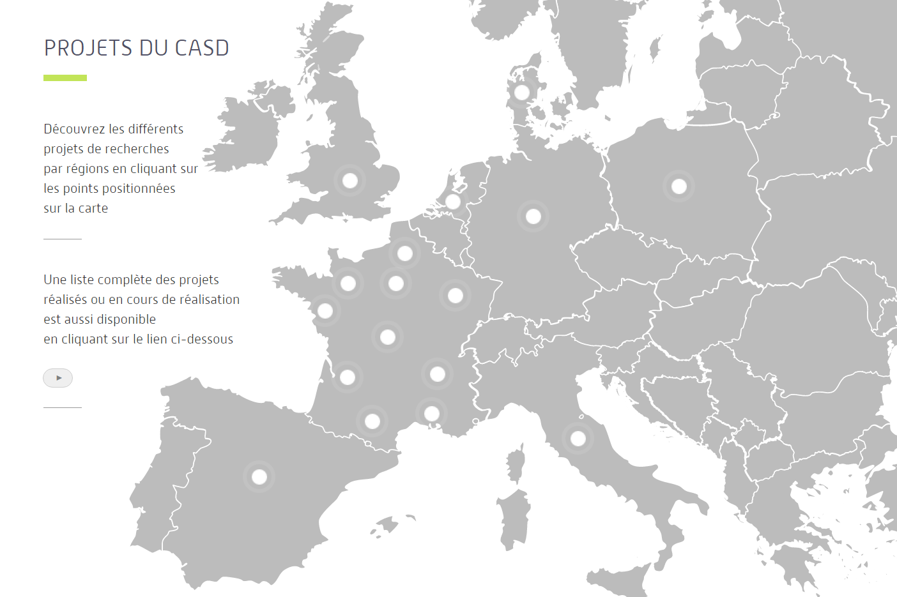
RADEs: France
Centre d’accès securisé distant (CASD, France)
Note: within same agency that enabled AKM (1999)
INSEE recommended implementing a secure center for accessing data (2007)
2008 modification to Statistics Law made possible pilot infracstructure
Pilot infrastructure becomes permanent in 2009
Expansion with per-project cost (invoicing) in 2012
Loi Informatique et Libertés (1978)
1985
1995
2008
2012
today
1990
1st working group
2007
2009
371 APs in 8 countries
Source: presentation to the CASD Scientific Committee in 2013
Notes:
1990 census was a trigger, when increased demand hit stronger privacy protection – demographers and sociologists
CREST was the original privileged access holder to data, but a driver in making it a more public entity.

Slide 200



basic paradigm
What type of access device?
What type of room?

Slide 201




remote processing paradigm

Slide 202
remote processing paradigm

Slide 203
synthetic data: validation model
Used for SIPP Synthetic Beta, Synthetic LBD
Researcher develops model on synthetic data
Assessment through submission of programs for “validation”
Researcher obtains results from programs run on confidential data, subject to traditional disclosure avoidance rules
No restrictions on types of models
In progress since 2011
Approx. 200 users
Approx. 6-8% of users request validation
Some unknown fraction “self-validate” through full FSRDC project

Slide 204
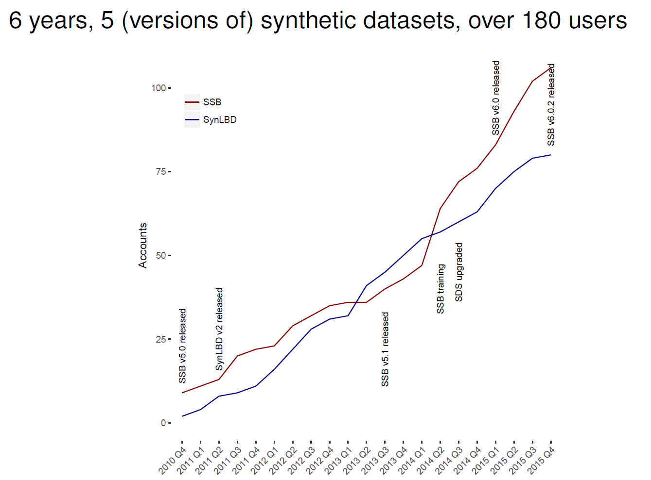
some results from Synthetic Data Server

Slide 205
Key insight (Lagoze and Vilhuber, 2017)
This cycle is already a part of replicable workflow:
Programs are run by third party on same (some RDCs)/ similar (synthetic data)
Accompanying documentation is needs to detail creation of results
Results are typically logged
(person conducting replication or reproducibility exercise)
This serves the same function as the typical “README” from replication archives!
Allows for assignment of DOIs!

Slide 206
Our recommendations
Access is already non-exclusive, and satisfied the reproducibility criteria
Document the access protocol clearly and in a citable, persistent fashion. Ensure access protocol is transparent and predictable
Provide to the researcher the information already present in administrative databased of RADEs (access rights)
Provenance of input data to which the researcher has access (data citation, metadata)
Systematically release the programs used to generate the output
Code archives for journals
Catalog the result files, possibly certify that they were generated from the programs
Provide a provable chain for the results in journals

Slide 207
Challenges
Creating a public catalog of data assets with
persistent identifiers,
best-practice data citations,
public metadata
Possible challenges in certifying that released results were created with the identified code
Used to be practice at IAB?
Often is a tabletop exercise (“plausibly generated by the code”)

Slide 208
Benefit
Data in RADEs can become FAIR at short notice:
Findable
Accessible
Interoperable
Reusable

Slide 209
Outlook

Slide 210
Moving forward in economics
Move away from “open access only” and “deposit at journal”
Systematically require that data be in a trusted repository
Trusted can be controlled but not (too) discriminatory access
Clear documentation of access policy, retention policy
Uniform treatment of open access, licensed, and confidential data
Systematically (but with sampling) verify reproducibility of code
Straightforward for OA and “easy-access” data
Less obvious, but not impossible for restricted-access (may be part of the process of releasing disclosable results)
Provide incentives and guidance to researchers to incorporate replicability into scientific workflow right from the start (not an afterthought)

Slide 211

thank you
lars.vilhuber@cornell.edu

Slide 212
Some References
Anderson, Richard G, William H Greene, Bruce D McCullough, and H D Vinod. “The Role of Data and Program Code Archives in the Future of Economic Research.” Working Paper. Federal Reserve Bank of St. Louis, 2005. http://research.stlouisfed.org/wp/2005/2005-014.pdf.
Bender, Stefan, and Jörg Heining. “The Research-Data-Centre in Research-Data-Centre Approach: A First Step Towards Decentralised International Data Sharing.” IASSIST Quarterly / International Association for Social Science Information Service and Technology 35, no. 3 (2011). http://www.iassistdata.org/iq/issue/35/3.
Bollen, Kenneth, John T. Cacioppo, Robert M. Kaplan, Jon A. Krosnick, and James L. Olds. “Social, Behavioral, and Economic Sciences Perspectives on Robust and Reliable Science.” Report of the Subcommittee on Replicability in Science Advisory Committee to the National Science Foundation Directorate for Social, Behavioral, and Economic Sciences. National Science Foundation, 2015. https://www.nsf.gov/sbe/AC_Materials/SBE_Robust_and_Reliable_Research_Report.pdf.
Camerer, Colin F., Anna Dreber, Eskil Forsell, Teck-Hua Ho, Jürgen Huber, Magnus Johannesson, Michael Kirchler, et al. “Evaluating Replicability of Laboratory Experiments in Economics.” Science, March 3, 2016, aaf0918. https://doi.org/10.1126/science.aaf0918.
Chang, Andrew C., and Phillip Li. “A Preanalysis Plan to Replicate Sixty Economics Research Papers That Worked Half of the Time.” American Economic Review 107, no. 5 (May 2017): 60–64. https://doi.org/10.1257/aer.p20171034.
Christian, Thu-Mai, Sophia Lafferty-Hess, William Jacoby, and Thomas Carsey. “Operationalizing the Replication Standard: A Case Study of the Data Curation and Verification Workflow for Scholarly Journals,” 2018. https://doi.org/10.17605/osf.io/cfdba.
Clemens, Michael A. “The Meaning of Failed Replications: A Review and Proposal.” Journal of Economic Surveys 31, no. 1 (February 1, 2017): 326–42. https://doi.org/10.1111/joes.12139.
Collaboration, Open Science. “Estimating the Reproducibility of Psychological Science.” Science 349, no. 6251 (August 2015): aac4716–aac4716. https://doi.org/10.1126/science.aac4716.
Dewald, William G, Jerry G Thursby, and Richard G Anderson. “Replication in Empirical Economics: The Journal of Money, Credit and Banking Project.” The American Economic Review 76, no. 4 (1986): 587–603.
Frisch, Ragnar. “Editor’s Note.” Econometrica: Journal of the Econometric Society 1, no. 1 (1933): 1–4.

Slide 213
Some References
Hamermesh, Daniel S. “Viewpoint: Replication in Economics.” Canadian Journal of Economics/Revue Canadienne d’économique 40, no. 3 (August 1, 2007): 715–33. https://doi.org/10.1111/j.1365-2966.2007.00428.x.
Höffler, Jan H. “Replication and Economics Journal Policies.” American Economic Review 107, no. 5 (May 2017): 52–55. https://doi.org/10.1257/aer.p20171032.
Jacoby, William. “AMERICAN JOURNAL OF POLITICAL SCIENCE GUIDELINES FOR PREPARING REPLICATION FILES.” American Journal of Political Science, 2005. https://ajpsblogging.files.wordpress.com/2015/03/ajps-guide-for-replic-materials-1-0.pdf.
Kidwell, Mallory C., Ljiljana B. Lazarević, Erica Baranski, Tom E. Hardwicke, Sarah Piechowski, Lina-Sophia Falkenberg, Curtis Kennett, et al. “Badges to Acknowledge Open Practices: A Simple, Low-Cost, Effective Method for Increasing Transparency.” Edited by Malcolm R Macleod. PLOS Biology 14, no. 5 (May 12, 2016): e1002456. https://doi.org/10.1371/journal.pbio.1002456.
Kinney, Satkartar K., Jerome P. Reiter, and and Javier Miranda. “SynLBD 2.0: Improving the Synthetic Longitudinal Business Database.” Statistical Journal of the International Association for Official Statistics 30 (2014): 129–135.
Kinney, Satkartar K, Jerome P Reiter, Arnold P Reznek, Javier Miranda, Ron S Jarmin, and John M Abowd. “Towards Unrestricted Public Use Business Microdata: The Synthetic Longitudinal Business Database.” International Statistical Review 79, no. 3 (December 2011): 362–384. https://doi.org/10.1111/j.1751-5823.2011.00153.x.
Kohlmann, Annette. “The Research Data Centre of the Federal Employment Service in the Institute for Employment Research.” Schmollers Jahrbuch : Journal of Applied Social Science Studies / Zeitschrift Für Wirtschafts- Und Sozialwissenschaften 125, no. 3 (2005): 437–47.
Kraus, R. “Statistical Déjà vu: The National Data Center Proposal of 1965 and Its Descendants.” Journal of Privacy and Confidentiality, 2013. http://repository.cmu.edu/jpc/vol5/iss1/1/.

Slide 214
Some References
Lagoze, Carl, and Lars Vilhuber. “Making Confidential Data Part of Reproducible Research.” Chance, 2017 2017. http://chance.amstat.org/2017/09/reproducible-research/.
McCullough, B D, Kerry Anne McGeary, and Teresa D Harrison. “Lessons from the JMCB Archive.” Journal of Money, Credit, and Banking 38, no. 4 (June 2006): 1093–1107.
U.S. Census Bureau. SIPP Synthetic Beta Version 6.0.2. Washington, DC and Ithaca, NY, USA, 2015. http://www2.vrdc.cornell.edu/news/data/sipp-synthetic-beta-file/.
Vilhuber, Lars, John M. Abowd, and and Jerome P. Reiter. “Synthetic Establishment Microdata Around the World.” Statistical Journal of the International Association of Official Statistics 32, no. 1 (2016): 65–68.

Slide 215
Picture references
Tug of War 1: Johnmoore6 at English Wikipedia - CC BY-SA 3.0, https://commons.wikimedia.org/w/index.php?curid=16357035
Tug of War 2: Bart Derksen at Dutch Wikipedia, CC BY-SA 3.0, https://commons.wikimedia.org/w/index.php?curid=3218716

